Slide 1
Process «Kayit Ol»
LOL- NfinityGames - Joygame

Slide 2
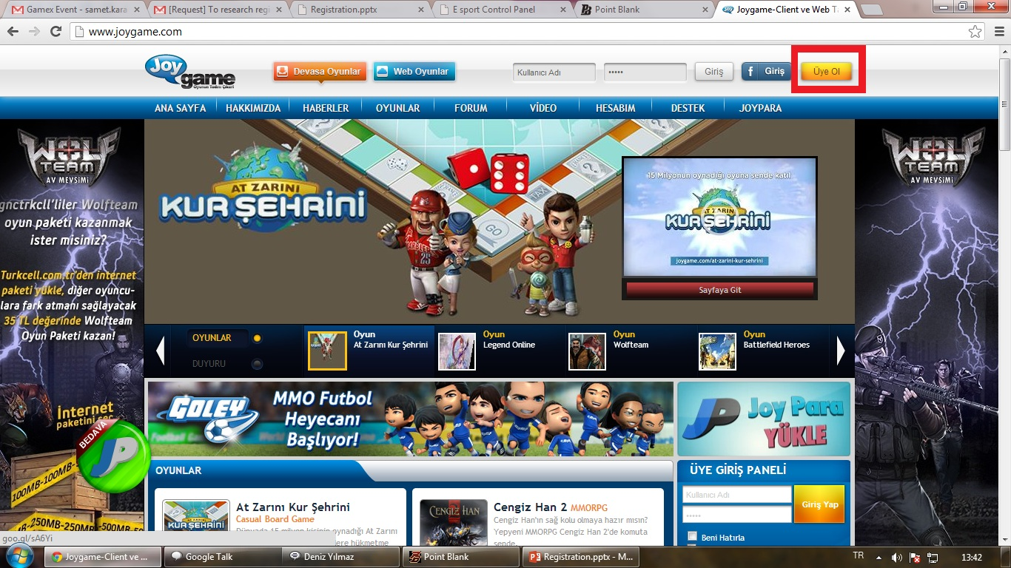
JoyGame Step 1

Slide 3
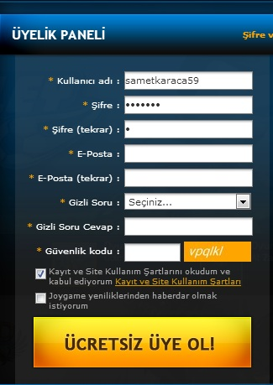
JoyGame Step 2
They request:
Username Password E-mail Security Question Security Answer
Security Code
Policy check box
News check box

Slide 4
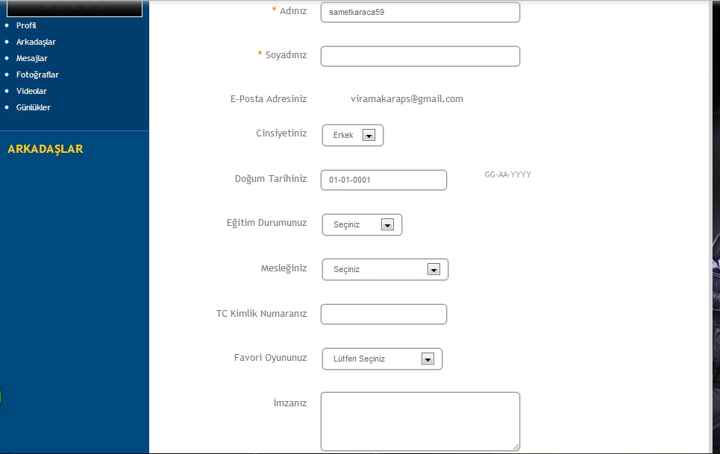
Joygame Step 3
You can fill optional part: Name,sex,birthdate,education,job,Turkey Id,favourite game,hobies.

Slide 5
JoyGame
You can fill your Turkey ID to website.But that website has not any security shield. Page has not ssl sertificate. So if the server hacked ; they can reach your Turkey ID. I don’t recommend it.
They didn’t send any e-mail.

Slide 6
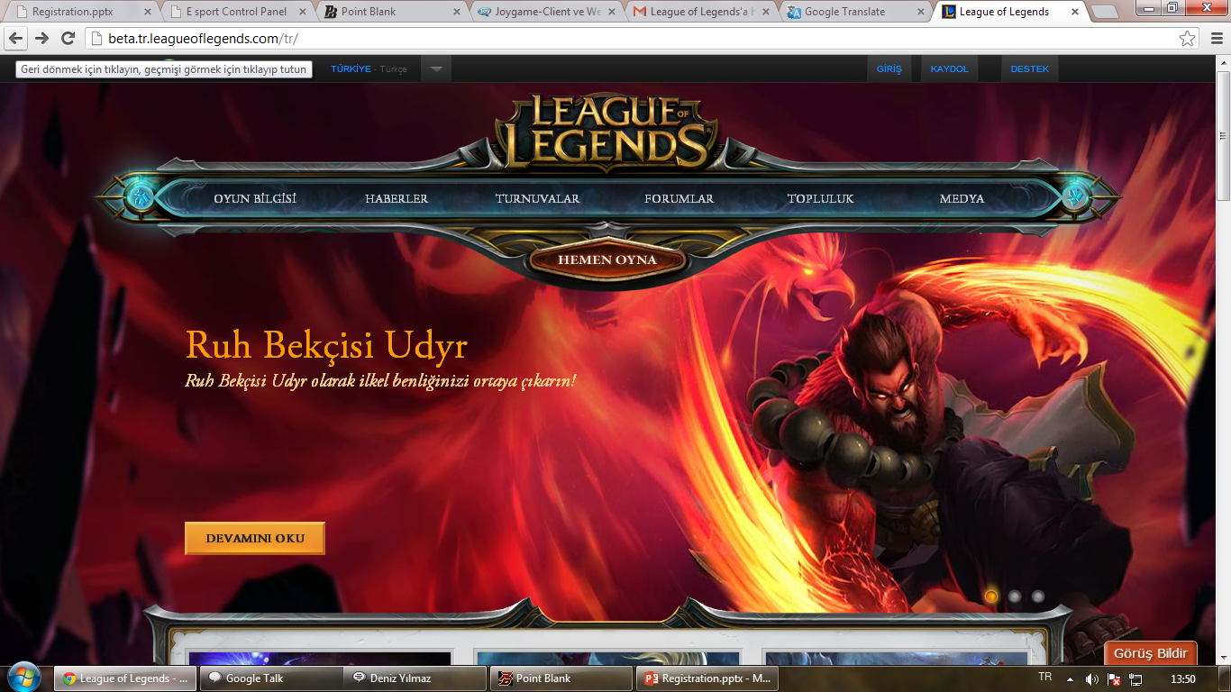
LOL Step 1

Slide 7
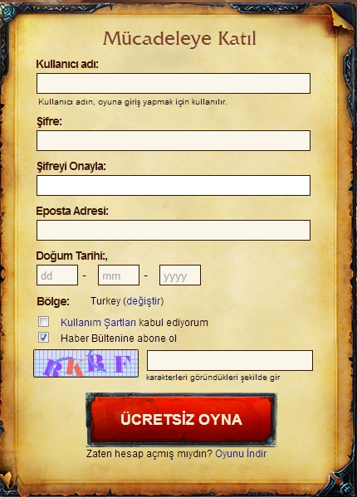
LOL Step 2
They request:
Username
Password
E-mail
Birthdate
They don’t request more thing and there is not security question.And page has not ssl sertificate.

Slide 8
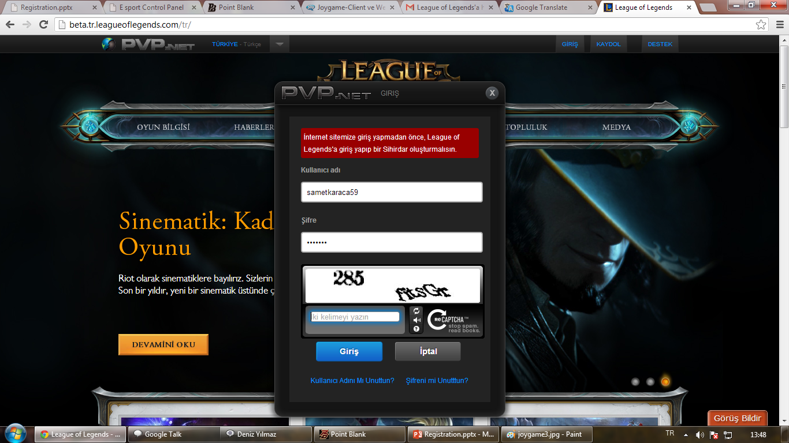
LOL Step 3

Slide 9
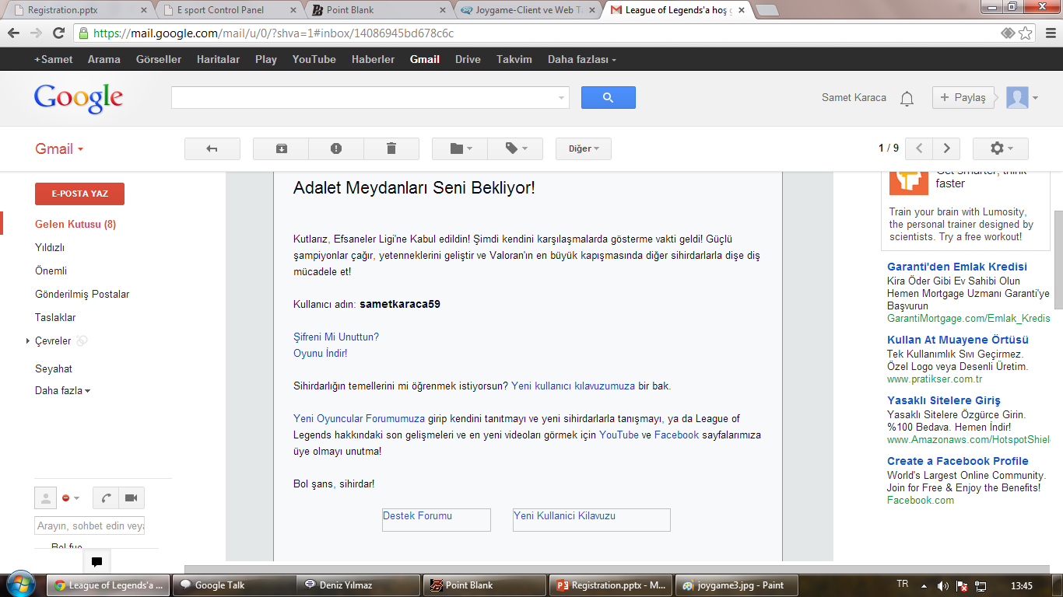
LOL Step 4

Slide 10
LOL Steps
Step 3:
You must join game and create a charachter.
If you don’t do it, you can’t join website.
Step 4:
They sent a mail.
There is not any activation.
Mail shows the link of guide and download.

Slide 11
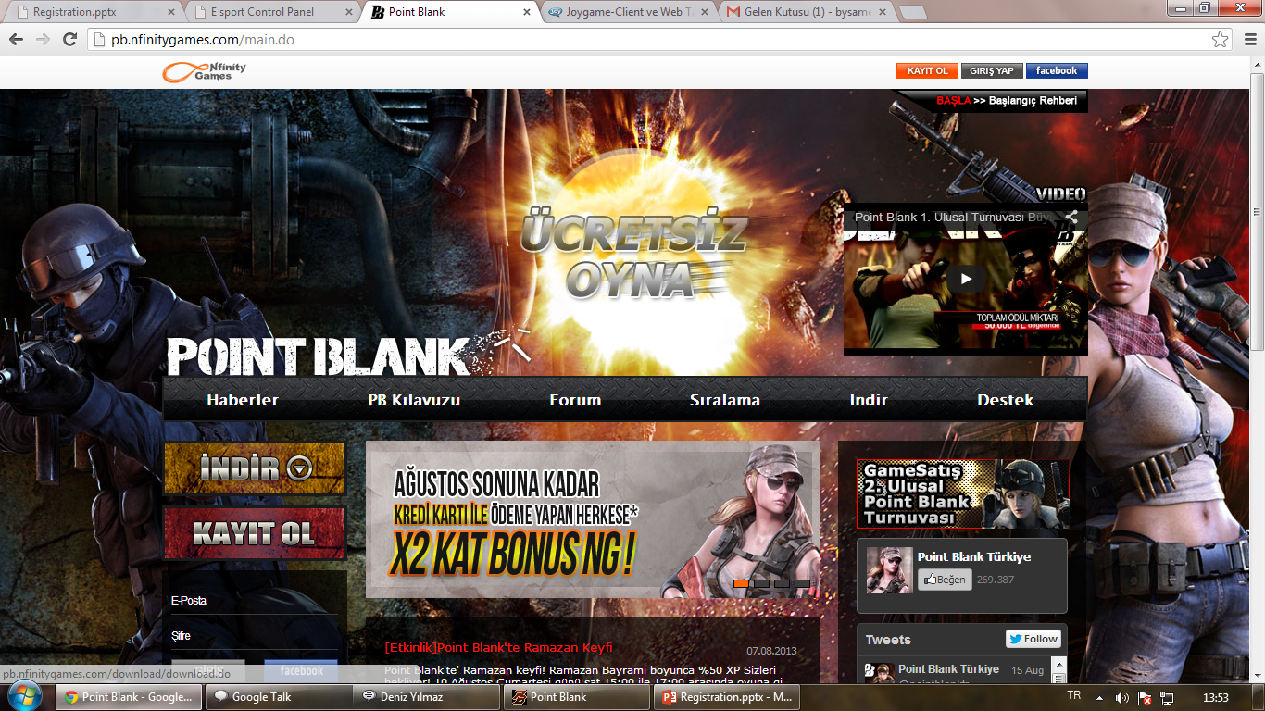
NfinityGames Step 1

Slide 12
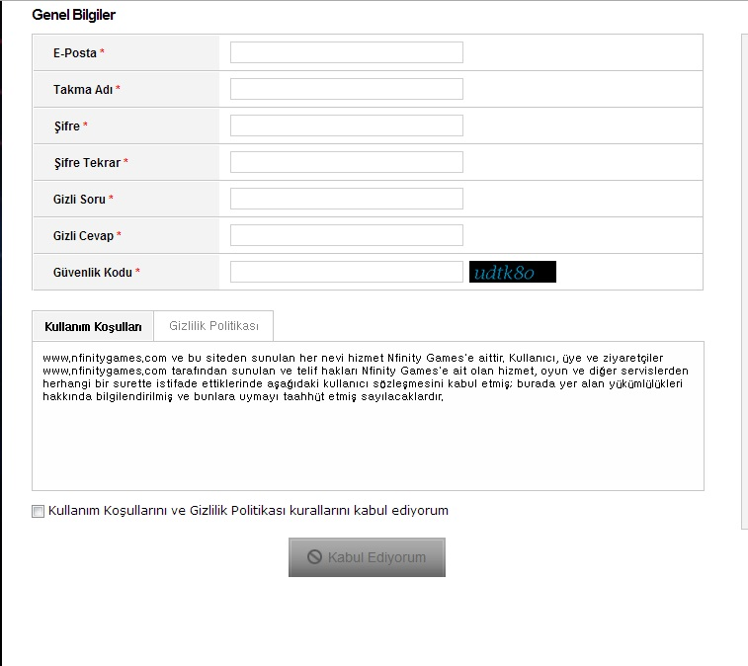
NfinityGames Step 2
E-mail Username
Password
Security Question
Page has not ssl
Sertificate.You cant change your main mail adress.It’s bad thing for me if you lost your main maill adress.

Slide 13
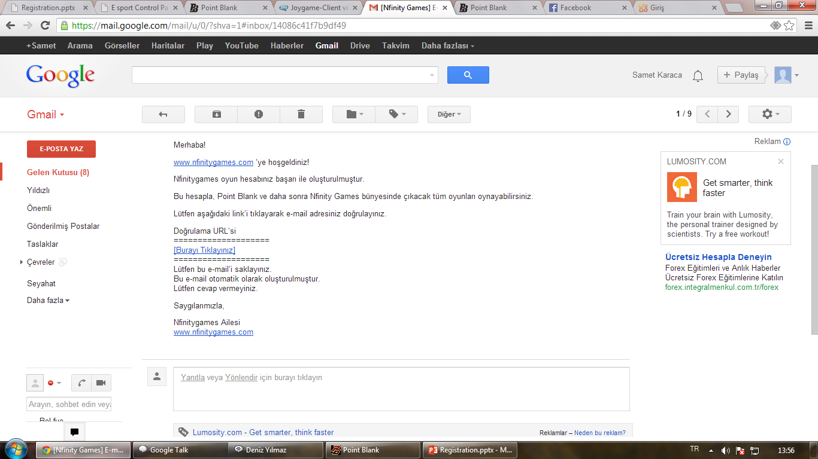
NfinityGames Step 3
You need to activate your account.

Slide 14
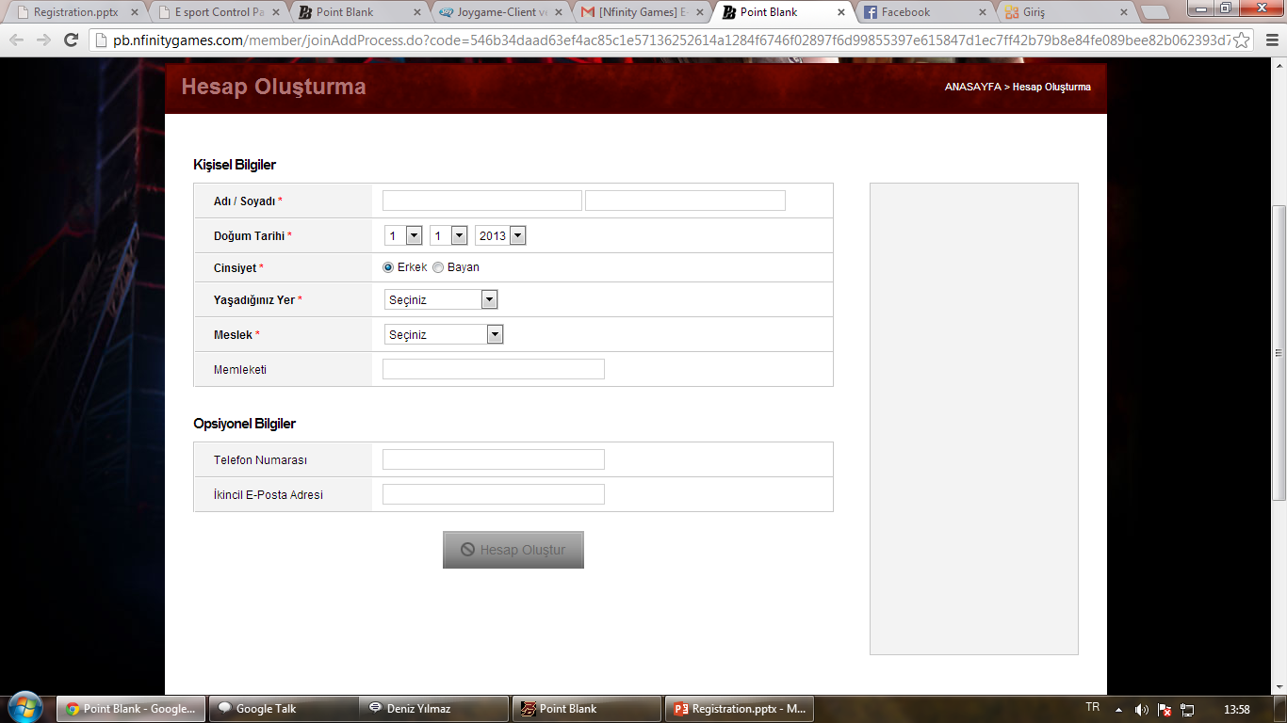
NfinityGames Step 4
You have to fill name,birthdate,sex,city,job.After them you can create account.

Slide 15
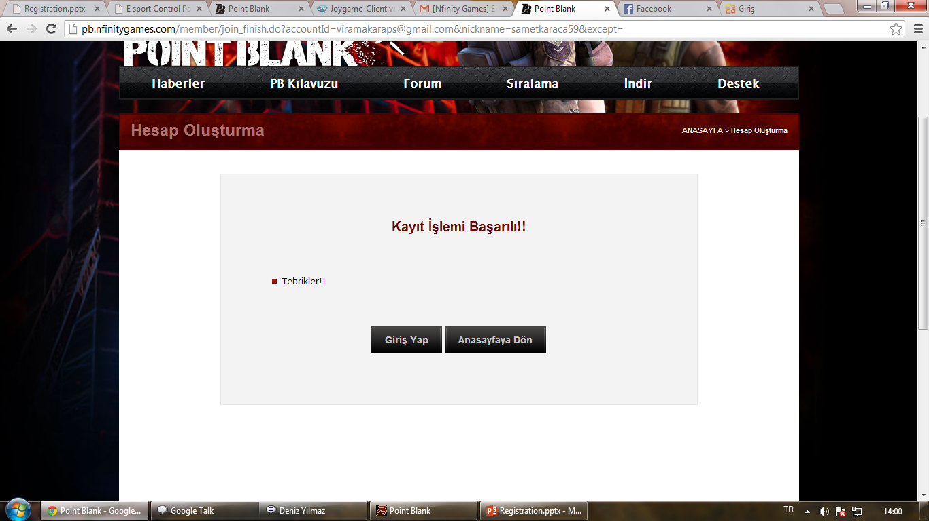
NfinityGames Step 5

Slide 16
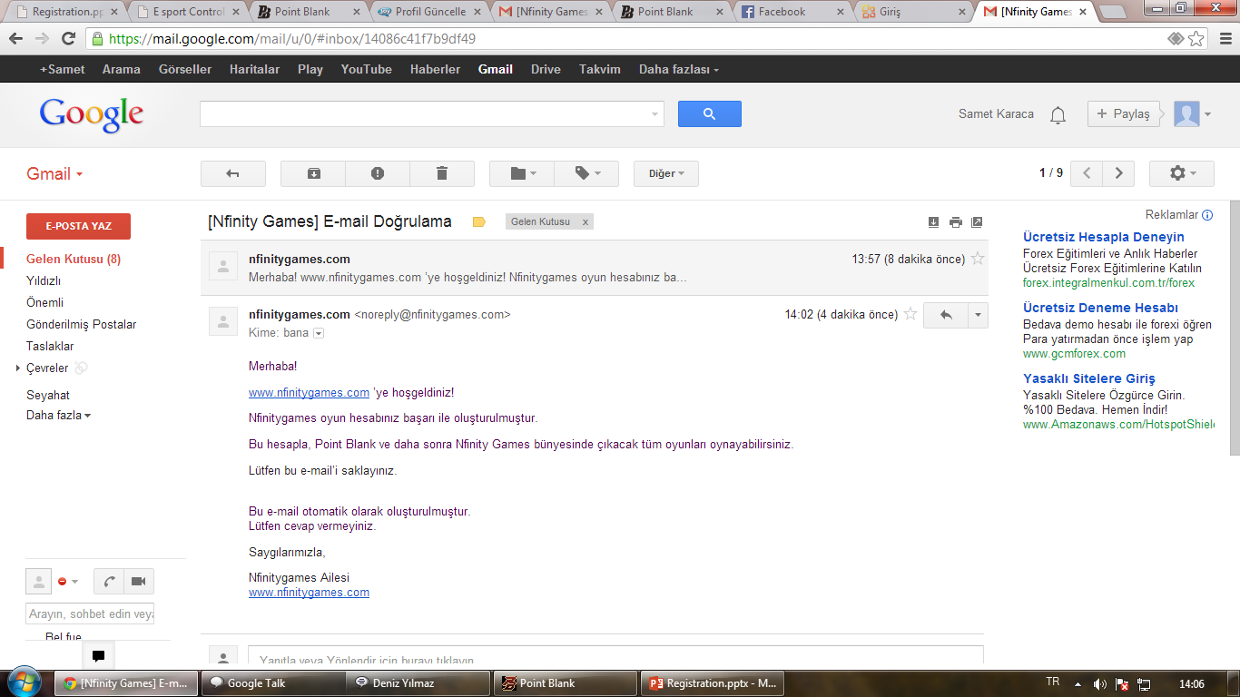
NfinityGames Step 6
When you created account succesfully, you get a mail about it.

